Slide 1
Face Detection(Team 4)
-Akshay A Menon(AM.EN.U4CSE18203)
-Ananthu Vasudevan ( AM.EN.U4CSE18206)
-Arun K Nair(AM.EN.U4CSE18208)
-krishnadas K S(AM.EN.U4CSE18231)

Slide 2
Problem Statement:
In the world of modern era, students who are attending the online have access with single as well as the multiple devices . Many of the people are not attending properly . For that solution we use face detection technology to mark the attendance.

Slide 3
Scope and relevence
A facial recognition system is a computer application for automatically identifying or verifying a person from a digital image or a video frame from a video source. One of the way is to do this is by comparing selected facial features from the image and a facial database.It is typically used in security systems and can be compared to other biometrics such as fingerprint or eye iris recognition systems. In this paper we focus on facial recognition system and biometric facial recognision system. We do critics on facial recognision system giving effectiveness and weaknesses. This paper also introduces scope of recognision system in India.

Slide 4
Innovations Used:
Here we use face detection technology for marking attendence for the students. If the students are not attending class the messages will be sent to the respective parents . The tecnology here we used is relational data base management system(RDBMS) and face detection technology.

Slide 5
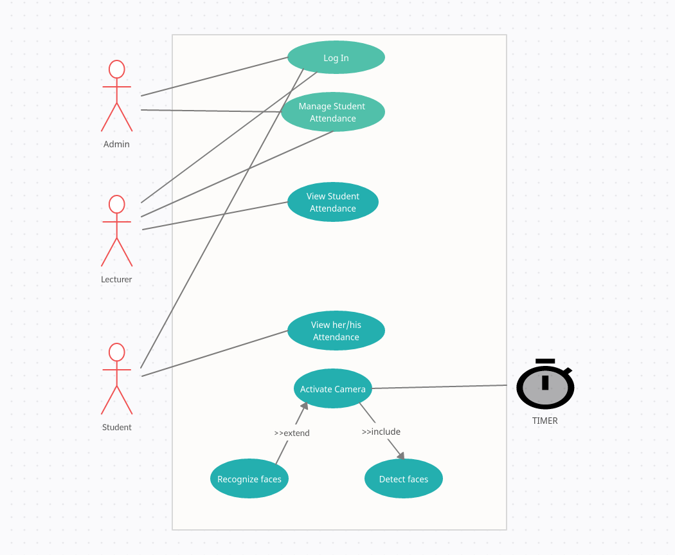
Use case diagram

Slide 6
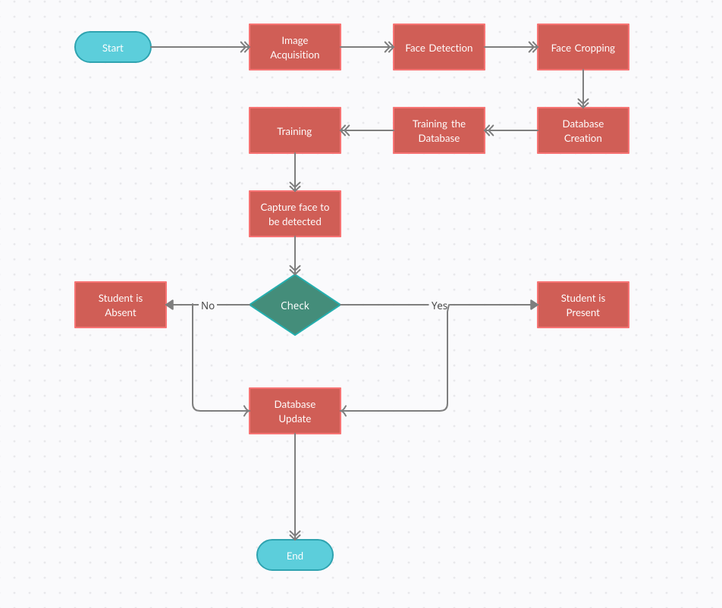
Activity diagram

Slide 7
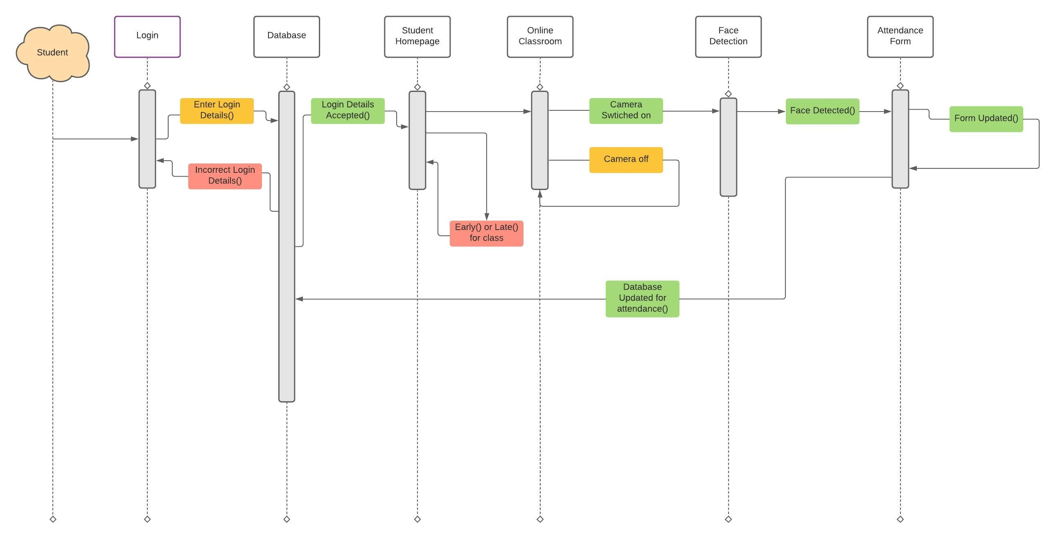
Sequence diagram

Slide 8
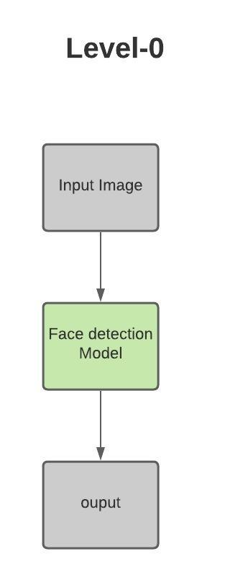
Dataflow Diagram

Slide 9
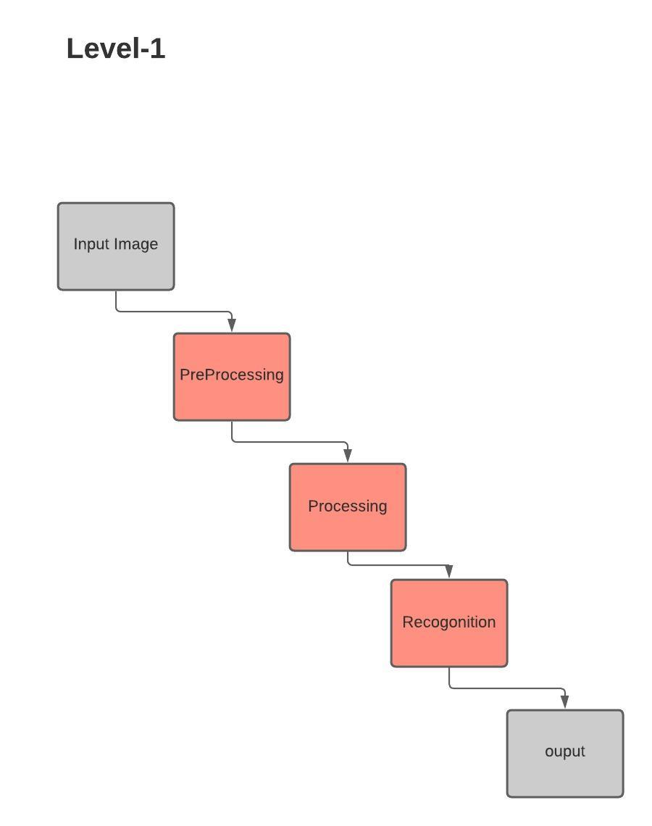

Slide 10
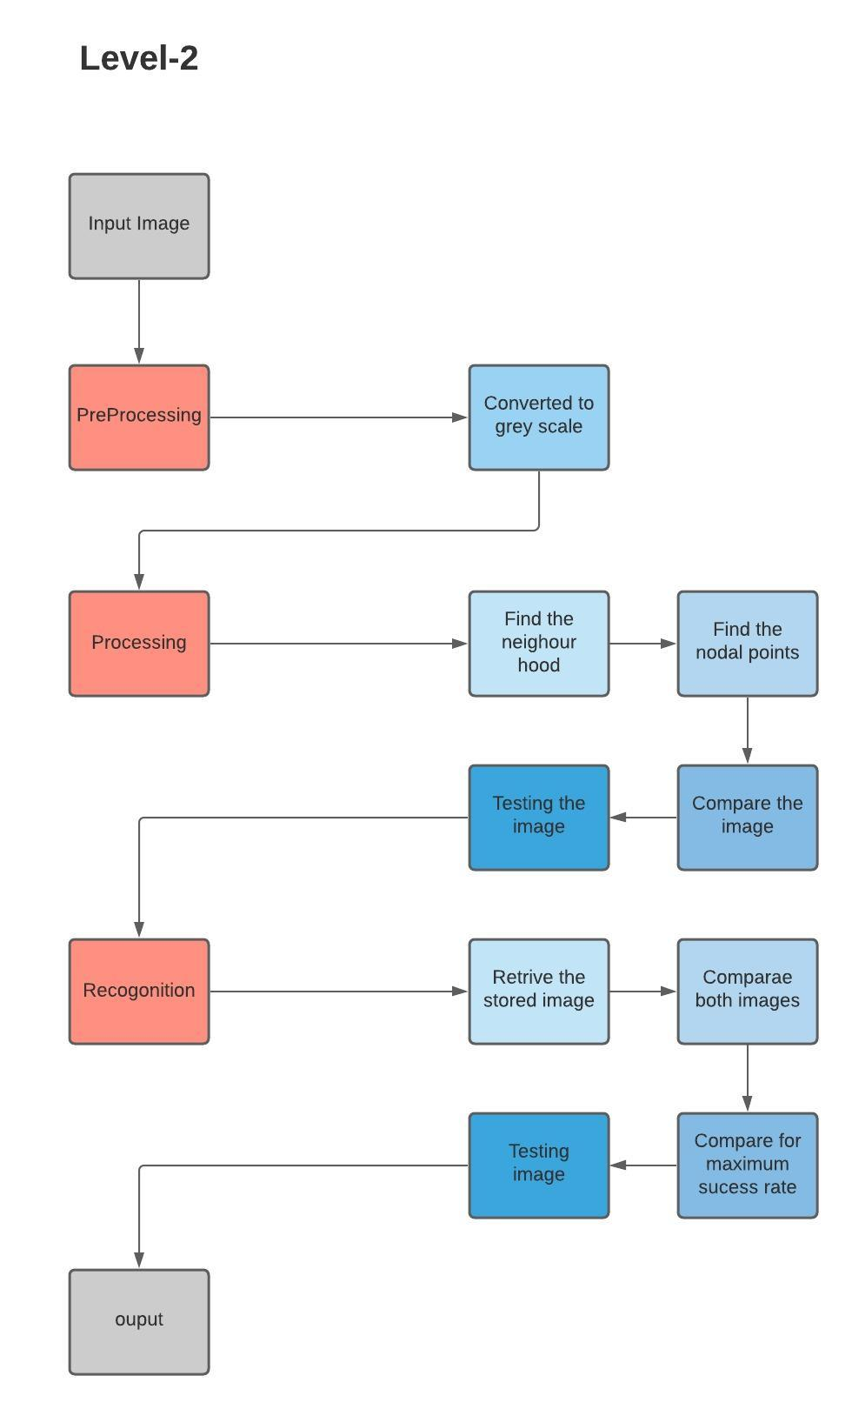

Slide 11
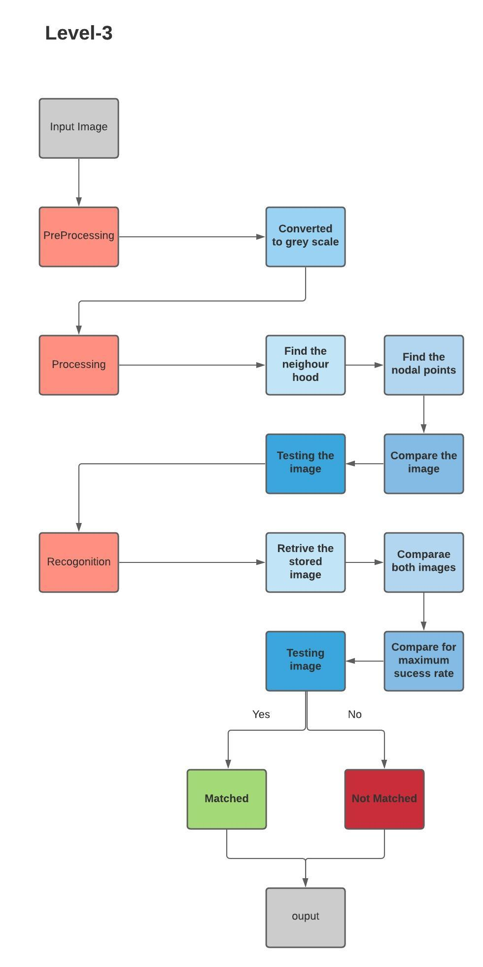

Slide 12
reference
https://ieeexplore.ieee.org/document/8534942
https://link.springer.com/chapter/10.1007/978-3-030-63319-6_69
https://www.researchgate.net/publication/341876647_Face_Recognition_based_Attendance_Management_System
https://www.ukessays.com/essays/education/recognition-attendance-system-6424.php

